Slide 1
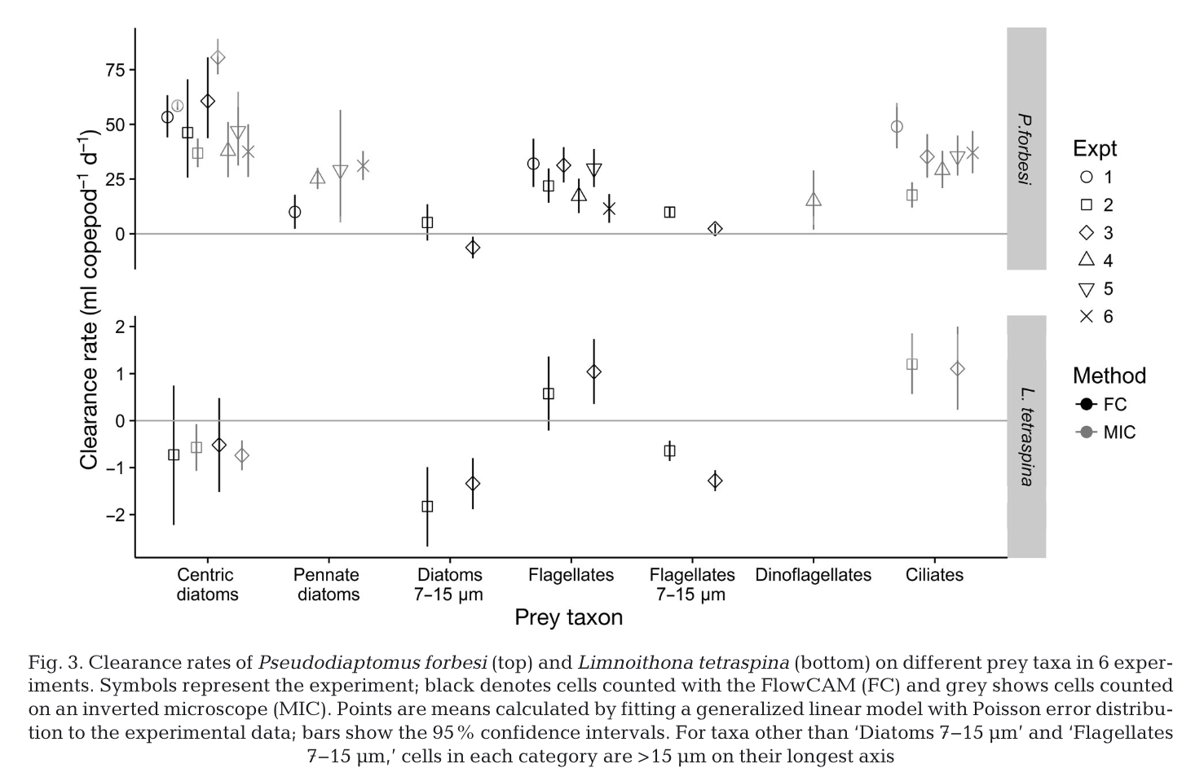
Kayfetz and Kimmerer 2017

Slide 2
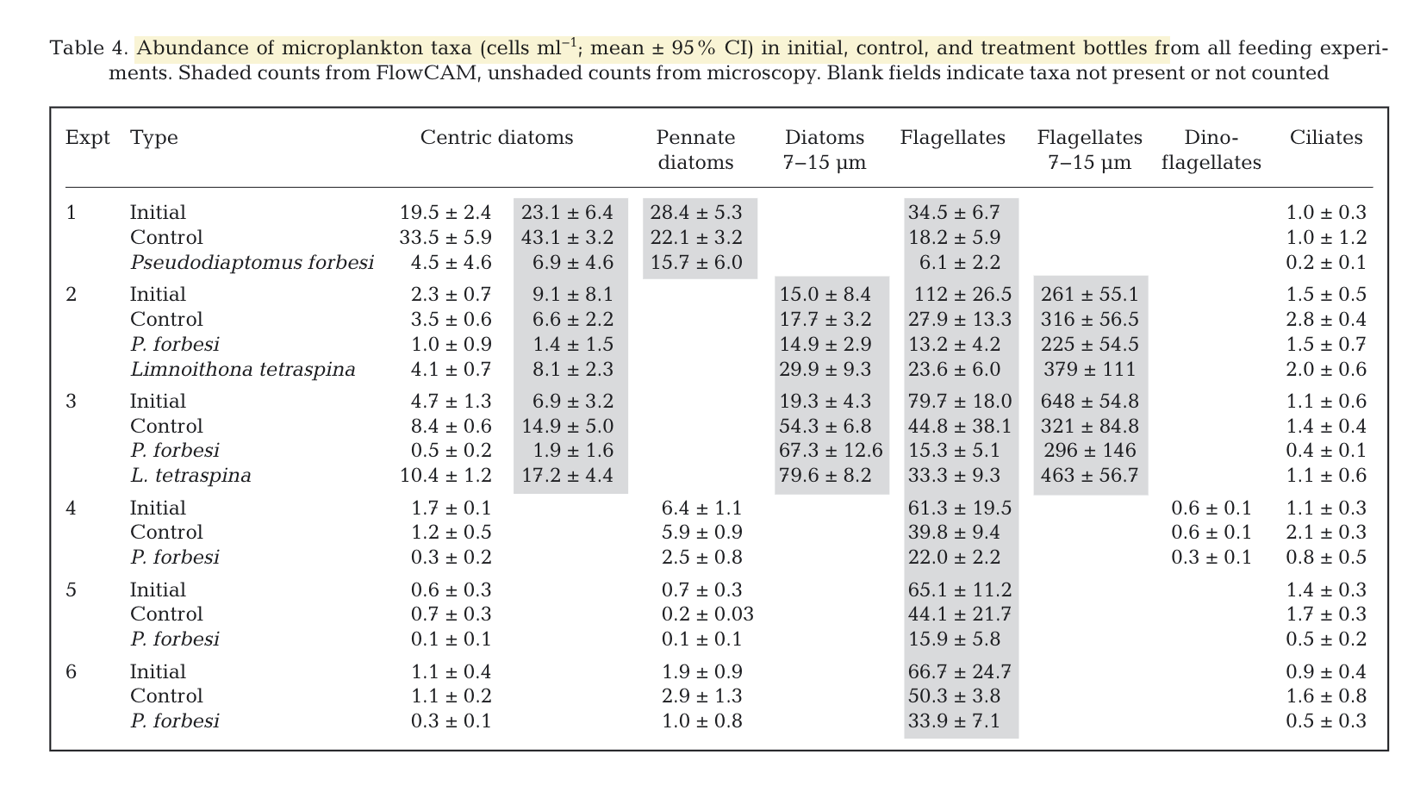
Kayfetz and Kimmerer 2017

Slide 3
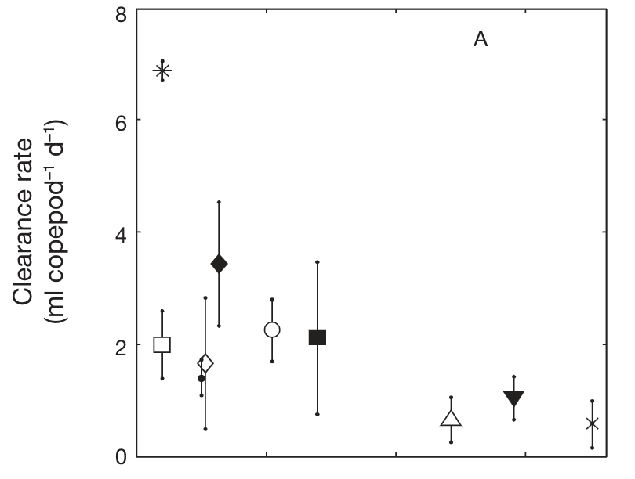
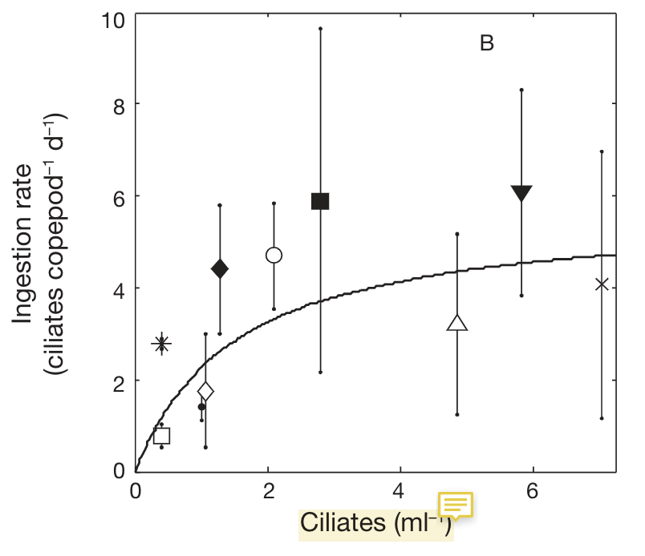
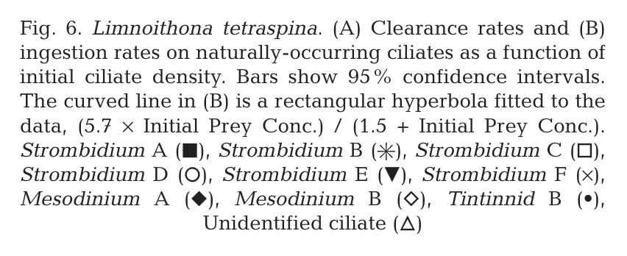
Bouley and Kimmerer 2006

Slide 4
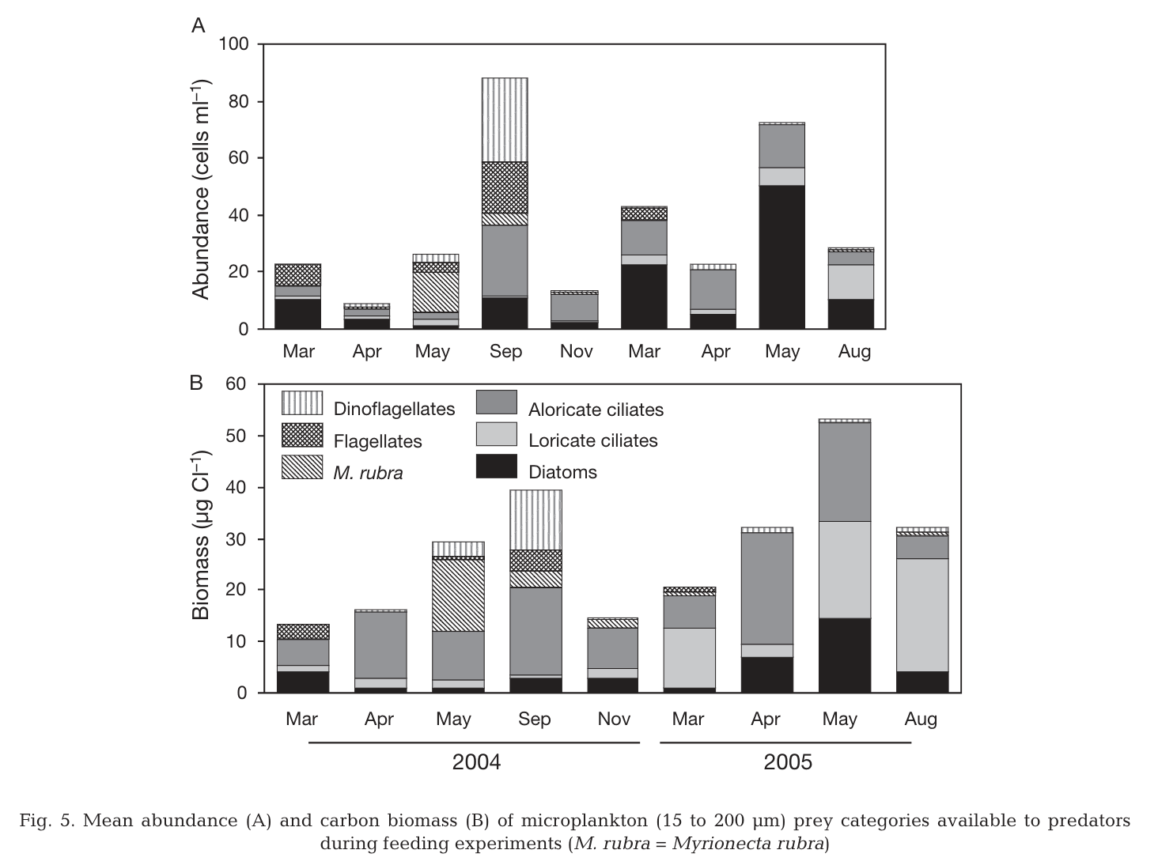
Gifford and Rollwagen Bollens 2007

Slide 5
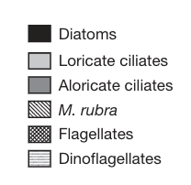
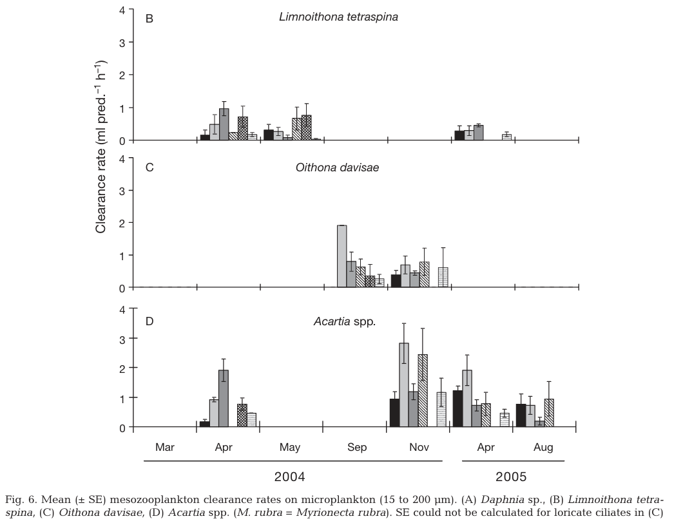
Gifford and Rollwagen Bollens 2007
Convert ml pred⁻¹ h⁻¹ to d⁻¹
Multiply by 24:
Ex: Acartia April 2004, aloricate ciliates, ~ 2ml per hour = ~ 48 ml per day
Acartia April 2005, diatoms
~ 1.5 ml per hour = ~ 36ml per day

Slide 6
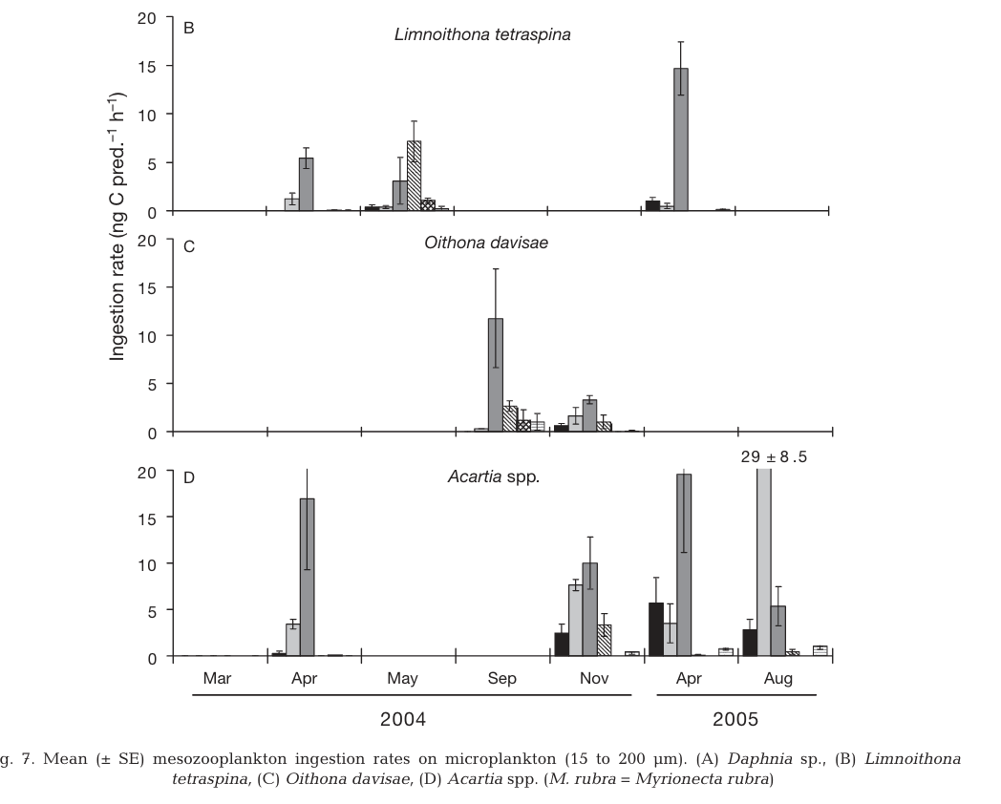
Gifford and Rollwagen Bollens 2007
Convert ng C pred⁻¹ h⁻¹ to µg C pred⁻¹ d⁻¹
1 ng = .001 µg
1 day = 24 hours
Ex: Acartia April 2004, aloricate ciliates,
~ 17 ng C per per hour = ~ .017 µg C per hour
Multiply .017 by 24 = ~ .408 µg C per day
Acartia April 2005, diatoms
~ 5 ng C per per hour = ~ .005 µg C per hour
Multiply .005 by 24 = ~ .12 µg C per day

Slide 7
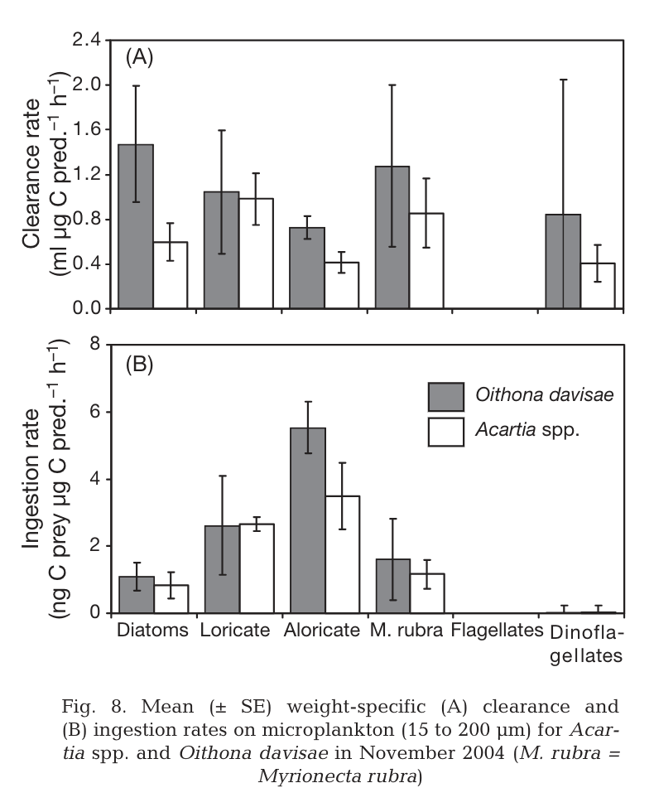
Gifford and Rollwagen Bollens 2007

Slide 8
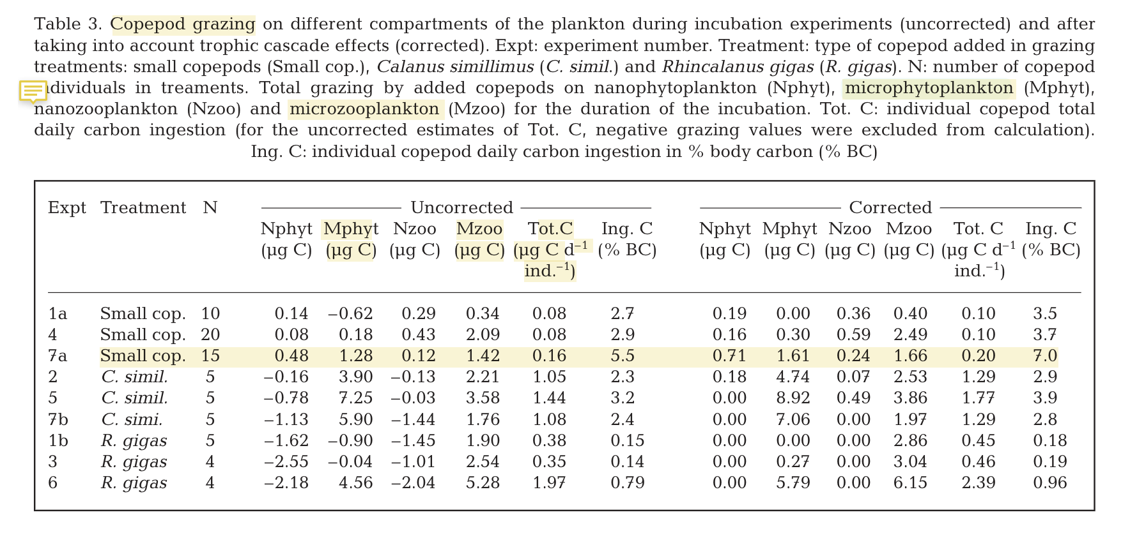
Klass et al 2008

